Slide 1
Example Statement:
Notes
Key

Slide 2
To be printed A3
Bot Design Workshop – Step1 : Business Goals
Notes
Heart
Mind
Key

Slide 3
Resulting value and scope statement
To be printed A3
Bot Design Workshop – Step1 : Business Goals
Notes
What:
Who:
Improving:
Key
Benefit:

Slide 4
To be printed A3
Bot Design Workshop – Step 2 : The Users
Notes
Name
Name
Name
Key
Notes:
When you start filling in the Persona sheet, ask them what the user’s name is, how old are they, where do they live, what job do they have, what are their hobbies. We really want to get a full understanding of the users so that we can create the right type of conversation with them.

Slide 5
To be printed A3
Bot Design Workshop – Step 3a : User Journey
Notes
Key

Slide 6
To be printed A3
Bot Design Workshop – Step 3b : User Journey
Notes
Bot Name
Key

Slide 7

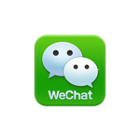
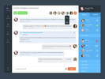
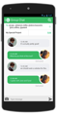

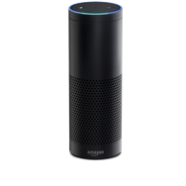
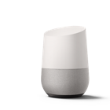

Step 4 – Channels Workbook
Chat Channel |  | Properties | Select | Why?
 | FB Messenger | > 1.2 Billion active users. Connect to FB Page
 | WeChat | > 1.1 Billion active users. Major dominance by far east users. Complete ecosystem
 | In Web | Most accessible does not need to depend on 3rd party messaging
 | In App | Allows linkage to custom mobile app
 | Slack | Enterprise messaing, Collaboration tool. Used extensively in DevOPs
 | Skype 4 Business | Enterprise messaging (being replaced by MSFT Teams)
 | Alexa, Google Home | Audio bot – communal setting. Hands free operation
 | Telegram | Dominant chat in some markets. E2E encryption
 | Text | Most used and most accessible. Limited interaction UI. Texts costed.
 | Voice IVR | Existing channel extensively used for customer service. Costly.
OTHER
Txt

Slide 8
Example Language support
Persona | Languages | Suggested POC languages

Slide 9
Example: Backend Architecture
Notes
Channels
Bots
Integration
Key
Analytics
Backends

